Slide 1
The State of Social Media
Cutting Through the Noise and Reaching Your Audience Online in 2022
July 16, 2022

Slide 2
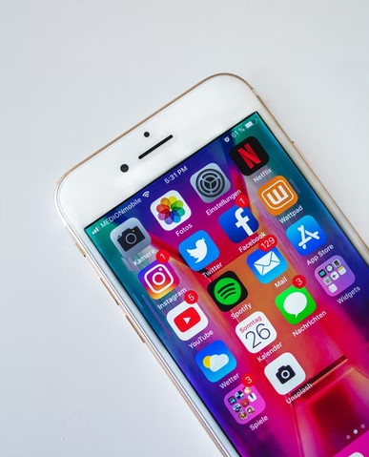
Agenda
Introduction
The Past, Present, and Future of Social Media
District Examples
Helping You Share Your ARP Stories
Q&A
The State of Social Media
Sara Kurfeß, Unsplash

Slide 3
Introduction

Slide 4
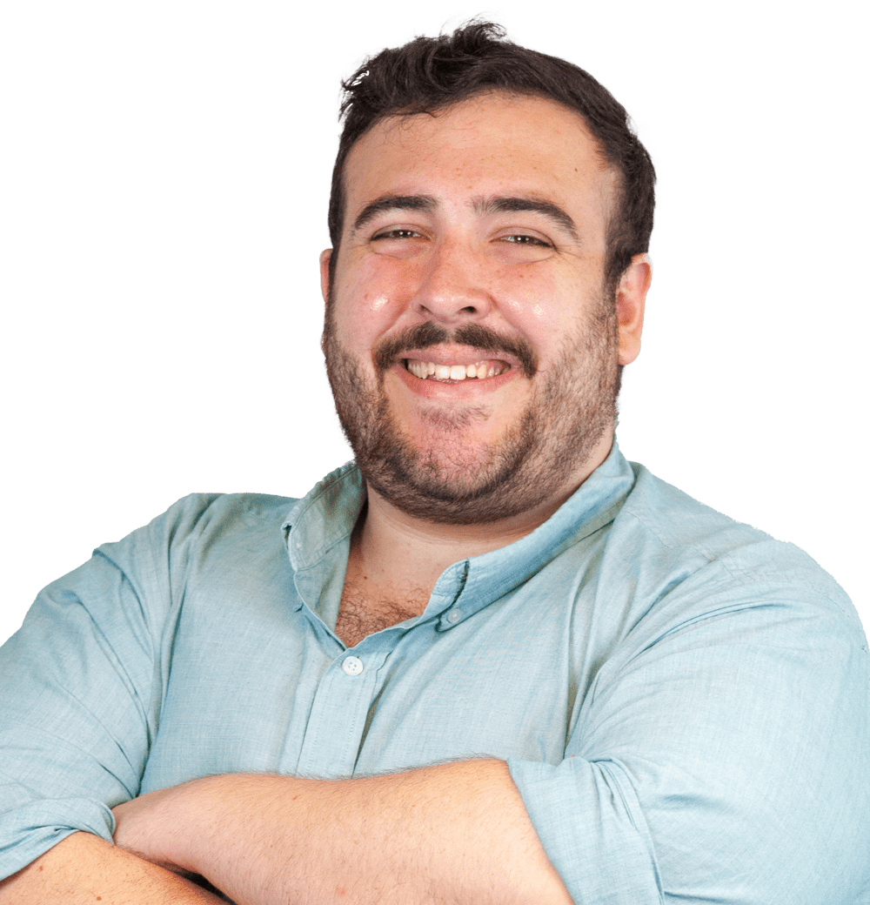
Introductions
Sami Ghani, Senior Director, Digital, The Hatcher Group
From Milwaukee, based in Chicago
Lifelong public-school student
Attended University of Wisconsin Madison
Passionate about storytelling through social media, email, and digital communications
Amateur bread baker
The State of Social Media

Slide 5
The Past, Present, and Future of Social Media

Slide 6
Technology Has Come a Long Way…
The Today Show, 1994
The State of Social Media

Slide 7
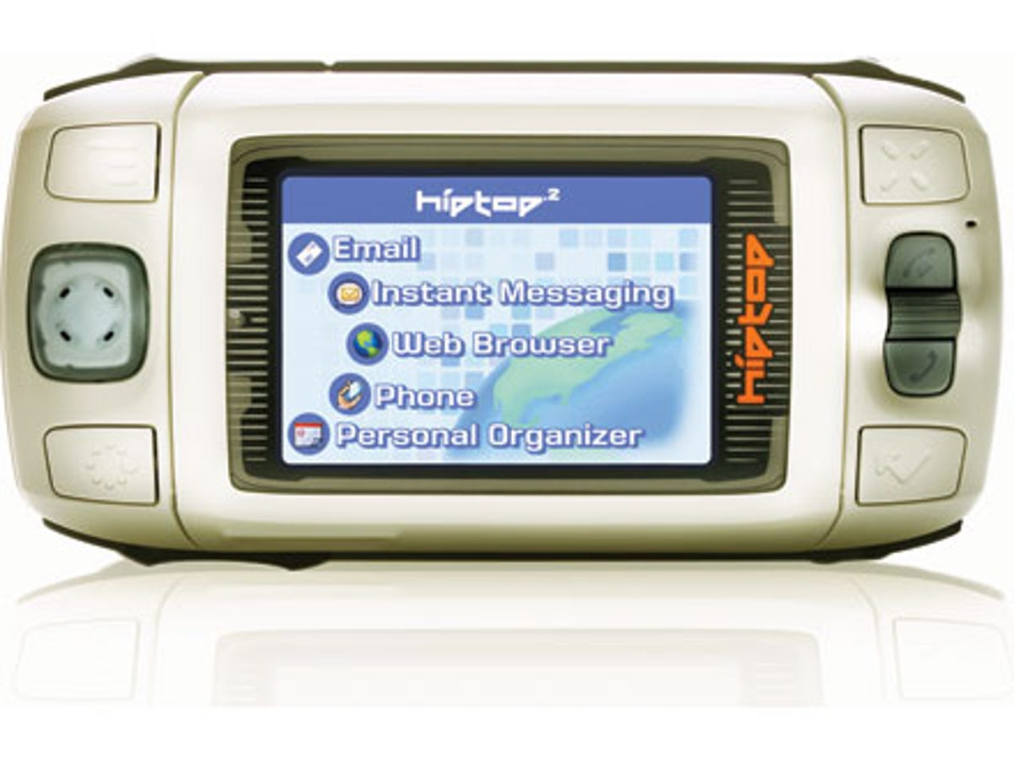
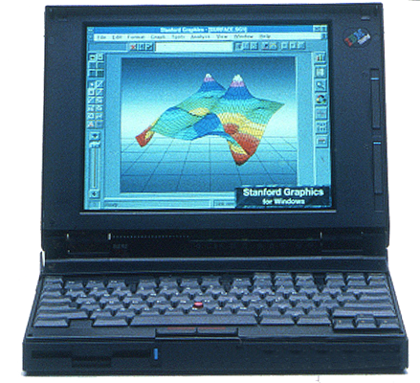
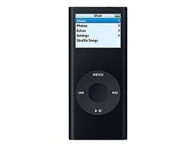
Technology Has Come a Long Way…
Facebook debuted in 2005 as “The Facebook,” while Twitter debuted in 2006
In their first year
The Facebook had 6 million users (2.936 billion today)
140 people signed up for Twitter in the first half of 2006 (229 million today)
Things have changed a lot since 2006
Telstra Hiptop 2 named as the future of smartphones
Schools ran trial programs with the IBM ThinkPad Notebook to see if students enjoyed having technology in the classroom
People thought watching a movie on their iPod Nano was the peak of media
The State of Social Media

Slide 8
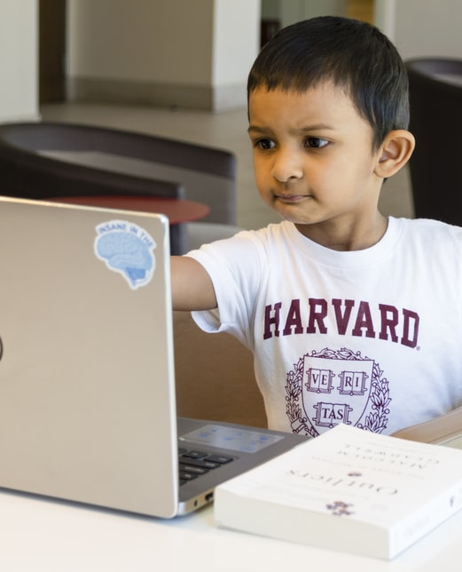
Social Media in 2022
Nearly all organizations reported an active presence on three platforms:
Instagram
Twitter
Facebook
YouTube and LinkedIn were used by 75% of organizations
23% of all organizations reported being on TikTok
No other social media platform reached 10% participation
The State of Social Media
Rohit Farmer, Unsplash

Slide 9
Facebook in 2022
Facebook’s algorithm punishes pages for posting too frequently
Most organizations posted once daily
Posting more than twice daily may hurt reach, hurting engagement
Death of organic engagement
Each organic Facebook post only reached 4% of a page’s fans
Media engagement rate is just 0.06%
Engagement score measures the number of users who interacted with a post as a percentage of page fans when the content was posted
Facebook Groups may be the exception
The role of paid content
The State of Social Media
Alexander Shatov, Unsplash

Slide 10
Instagram in 2022
Instagram is used by all
Skews young, but formerly biased heavily towards young people
Used by students, parents, community members, educators
Communicating through Reels and Stories
91% of users watch video weekly on the app
Allows more frequent posting, higher engagement
Average engagement rate of 0.67%
The role of paid content
The State of Social Media
Alexander Shatov, Unsplash

Slide 11
Twitter in 2022
Engagement rate is low, with a caveat
0.04% engagement rate
Platform is engaged with different than Facebook and Instagram
Average page posts five times weekly
Role for a district
Most public-facing platform
The State of Social Media
Alexander Shatov, Unsplash

Slide 12
TikTok in 2022
Requirements for success
Audience
Collateral
Consistency
Reaching students
Is it right for us?
The State of Social Media
Alexander Shatov, Unsplash

Slide 13
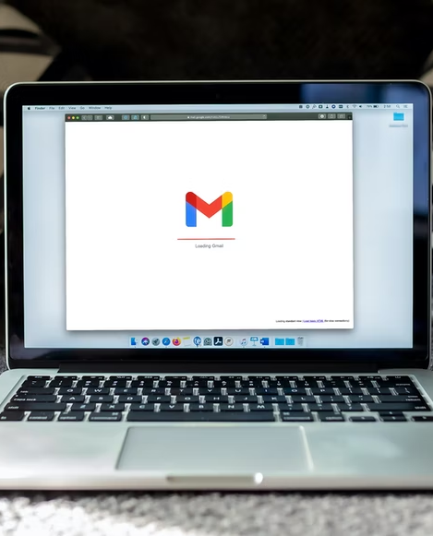
Email in 2022
Still one of the best ways to share information with an interested audience
Types of email constituencies
Parents
Staff
Community
Opportunity to highlight diverse voices and specialize content
Limits of the platform
The State of Social Media
Alexander Shatov, Unsplash

Slide 14
Offline Communications
Text messaging
Printouts
In person communication
Recognize when direct communication is essential for a situation, group, or topic
The State of Social Media
Zackary Drucker, The Gender Spectrum Collection

Slide 15
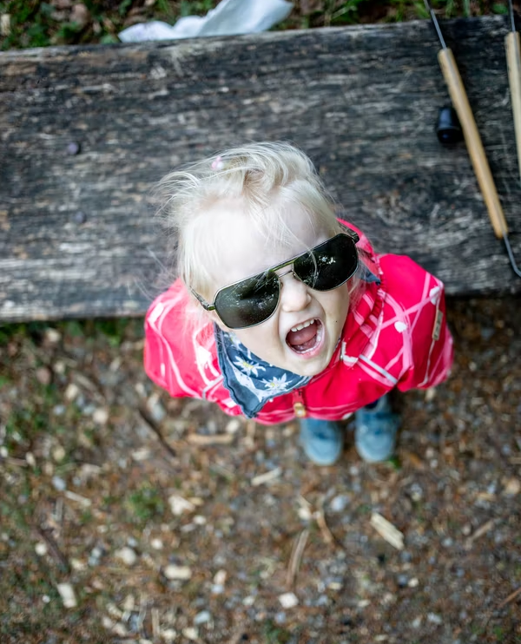
Overcoming 2022 Noise
Election year
Constant political/social issue discussions
Loud, aggressive, conflict-related content succeeds online
Tactics
Paid social, where available
Potential power of groups
Short, informal video
Community and staff buy-in
Owning the narrative online just by being there
Prioritizing regular content
Offering reprieve from overwhelming content
The State of Social Media
Timon Studler, Unsplash

Slide 16
District Examples

Slide 17
A Decade of Growth
District | 2012 Twitter Followers | 2022 Twitter Followers
Boston | 5,350 | 40,500
Chicago | 6,328 | 89,700
Houston | 4,808 | 166,200
Jefferson County | 2,503 | 118,700
Los Angeles | 4,335 | 39,400
The State of Social Media

Slide 18
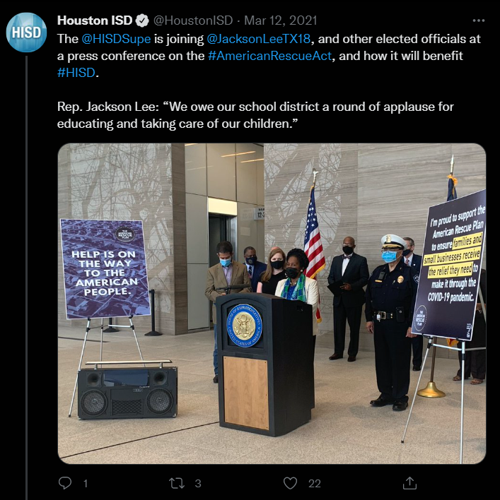
Houston
Strong example of conveying relevant information about big picture news
Thread highlighting American Rescue Act press conference
Uses appropriate hashtags
Tags internal and external handles
Strong visual content
The State of Social Media

Slide 19
Los Angeles
Post speaking directly to target audience of people most likely to follow on Facebook
Simple, but eye-catching graphic
Hashtag use
Branding
Doesn’t have same utility as on Twitter, and that’s ok
The State of Social Media

Slide 20
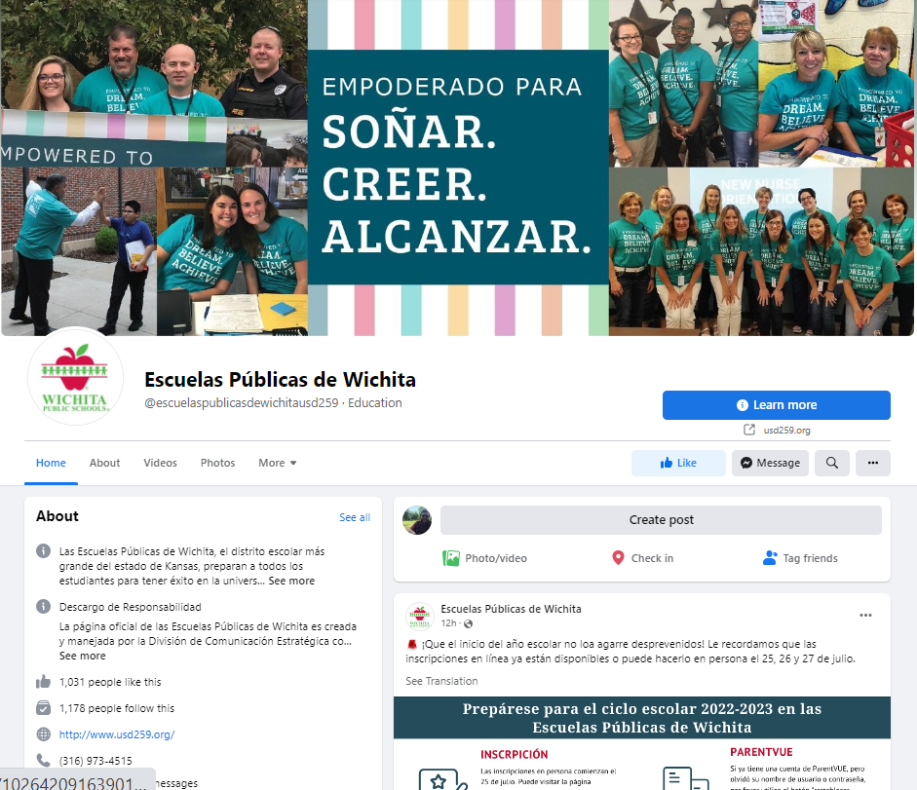
Wichita
Facebook Group for Spanish-speaking families
Takes resources and staff
Creates engaging, welcoming, and active space for information
The State of Social Media

Slide 21
Helping You Share Your ARP Stories Online

Slide 22
Content Built for You
Hatcher is working with the Council on three toolkits that will be shared throughout the next 12 months, starting with content around back to school
Repurposing press release content into something visually exciting and engaging
Focus on uplifting and filling capacity gaps
Quarterly paid campaigns
Focused on building awareness and owning the online narrative
Highlighting the work of the Council and members around ARP-spending
Short, direct, and customizable toolkits
Canva templates, sized for platforms
Content examples for Facebook and Twitter that can be used on other platforms as well
Space for district logos, brandmarks, and editable text to make it work for you
Examples of successful content and stories to model
The State of Social Media

Slide 23
Q&A

Slide 24
Thank You! Sami Ghani sghani@thehatchergroup.com

